Slide 1
Stablecoins vs. Mastercard and Visa
Disruption or Integration?
Dr. Matthias Hafner, May 23, 2025

Slide 2
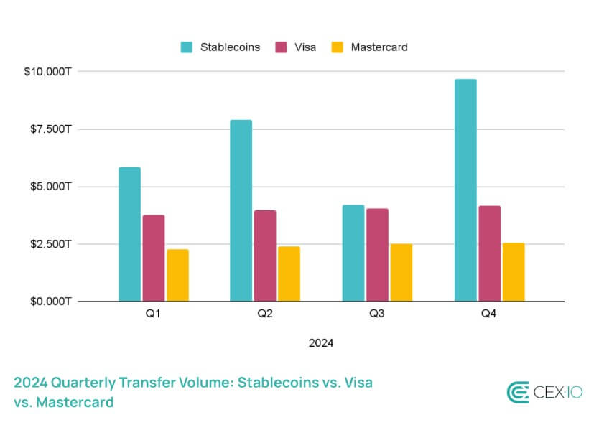
Stablecoins vs. Mastercard and Visa
Disruption or Integration?
New GENIUS Act
“[…]With those protections in place,
I expect this will be a $2.5 trillion market in no time.
Close your eyes and imagine a world where JPMorgan and Bank of America issue stablecoins,
where Amazon gives you a 2% discount if you buy using stablecoins instead of Visa,
and where it’s as common to accept stablecoins as it is to accept Venmo or PayPal.
That’s the world we’re going to be living in soon.”
(Matt Hougan, 21th May, 2025)
Stablecoins’ Development
But: the most volume in cryptoasset trading.
→ Do Stablecoins eventually replace Mastercard and Visa?
Stablecoins vs. Mastercard and Visa
Notes:
46

Slide 3
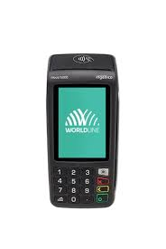
Visa / Mastercard Scheme I
Information Flow
Msg: EUR 10 from Customer X
Customer’s Bank («Issuer»)
3
Shop’s Bank («Acquirer»)
Intermediaries
Msg: EUR 10 from Customer X
2
Customer X: I want to pay EUR 10
Customer X
1
Shop («Merchant»)
Transaction

Slide 4
Visa / Mastercard Scheme II
Payment Flow
Msg: EUR 10 from Customer X
Customer’s Bank («Issuer»)
3
Shop’s Bank («Acquirer»)
Intermediaries
5
EUR 10
EUR 10
Msg: EUR 10 from Customer X
6
2
4
Account: - EUR 10
Customer X: I want to pay EUR 10
Account: + EUR 10
Customer X
1
Shop («Merchant»)
Transaction

Slide 5
Stablecoin Scheme
A Simple Solution
2
Wallet: - EUR-S 10
2
Wallet: - EUR-S 10
Customer X
1
Customer X: Send EUR-S 10
Shop («Merchant»)
Transaction
2
EUR-S 10

Slide 6
Visa / Mastercard Scheme III
Why Acquirer? Because it is not efficient if a merchant enters into an agreement with each bank in the world.
Why is it so Complicated?
Msg: EUR 10 from Customer X
Customer’s Bank («Issuer»)
3
Shop’s Bank («Acquirer»)
Intermediaries
5
EUR 10
EUR 10
Msg: EUR 10 from Customer X
6
2
4
Account: - EUR 10
Customer X: I want to pay EUR 10
Account: + EUR 10
Customer X
1
Shop («Merchant»)
Transaction

Slide 7
Visa / Mastercard Scheme IV
Why is it so Complicated?
VisaNet / Banknet
Msg: EUR 10 from Customer X
Customer’s Bank («Issuer»)
3
Shop’s Bank («Acquirer»)
Intermediaries
5
10 EUR
EUR 10
Msg: EUR 10 from Customer X
6
2
Why Visa / Master? Because it is not efficient if an acquirer enters into an agreement with each bank in the world.
In addition:
Visa/Master verifies if account has money
Visa/Master verifies AML/KYC
Visa/Master provides additional services (fraud detection)
4
Account: -10 EUR
Customer X: I want to pay EUR 10
Account: + EUR 10
Customer X
1
Shop («Merchant»)
Transaction

Slide 8
Visa / Mastercard Scheme V
Why is it so Complicated?
Msg: EUR 10 from Customer X
1% fee to Customer’s Bank
Customer’s Bank («Issuer»)
3
Shop’s Bank («Acquirer»)
Intermediaries
5
10 EUR
1% fee to Shop’s Bank
10 EUR
Msg: EUR 10 from Customer X
6
2
4
Account: - EUR 10
Customer X: I want to pay EUR 10
Account: + EUR 9.8
Customer X
1
Shop («Merchant»)
Transaction
Merchant does not like the system because of high fees, but customer wants to pay by credit card.

Slide 9
Stablecoin Integration: Issuer I
Gnosis and MetaMask Offer Payments Using Cryptowallets
Customer’s Bank («Issuer»)
Shop’s Bank («Acquirer»)
Intermediaries
EUR 10
Gnosis / MetaMask
EUR 10
Account: - EUR-S 10
Account: + EUR 10
Customer X
Shop («Merchant»)
Transaction
Solution for crypto natives who already have a wallet; relies on VisaNet/Banknet.

Slide 10
Stablecoin Integration: Issuer II
Gnosis and MetaMask Offer Payments Using Cryptowallets
Customer’s Bank («Issuer»)
Shop’s Bank («Acquirer»)
Intermediaries
EUR 10
Gnosis / MetaMask
The only difference: A stablecoin account, with fiat conversion by Gnosis or MetaMask’s issuer bank.
EUR 10
Account: - EUR-S 10
Account: + EUR 10
Customer X
Shop («Merchant»)
Transaction
Solution for crypto natives who already have a wallet; relies on VisaNet/Banknet

Slide 11
Stablecoin Integration: Issuer III
Gnosis and MetaMask Offer Payments Using Cryptowallets
Customer’s Bank («Issuer»)
0.5% fee to Customer’s Bank
Shop’s Bank («Acquirer»)
Intermediaries
EUR 10
0.5% fee to Gnosis /MetaMask
1% fee to Shop’s Bank
MetaMask / Gnosis
EUR 10
Account: - EUR-S 10
Account: + EUR 10
Customer X
Shop («Merchant»)
Transaction
Solution for crypto natives who already have a wallet.

Slide 12
Stablecoin Integration: Acquirer I
Stripe Offers Stablecoin Integration to Crypto Natives
Stripe
Customer’s Bank («Issuer»)
Shop’s Bank («Acquirer»)
Intermediaries
EUR-S 10
EUR 10
Account: - EUR-S 10
Account: + EUR 10
Customer X
Shop («Merchant»)
Transaction
EUR-S 10
Solution for crypto natives who already have a wallet.

Slide 13
Stablecoin Integration: Acquirer II
Stripe Offers Stablecoin Integration to Crypto Natives
Stripe
Customer’s Bank («Issuer»)
Shop’s Bank («Acquirer»)
Intermediaries
EUR 10
EUR-S 10
Account: - EUR 10
Account: + EUR-S 10
Customer X
Shop («Merchant»)
Transaction
Faster payment solution for merchants, powered by VisaNet/Banknet.

Slide 14
Stablecoin Integration: Acquirer III
Stripe Offers Stablecoin Integration to Crypto Natives
Stripe serves as an on/off ramp for wallet users.
Stripe
Customer’s Bank («Issuer»)
Shop’s Bank («Acquirer»)
Intermediaries
10 EUR-S
EUR 10
Account: - EUR-S 10
Account: + EUR 10
Customer X
Shop («Merchant»)
Transaction
10 EUR-S
Solution for crypto natives who already have a wallet.

Slide 15
Stablecoin Integration: Acquirer IV
Stripe Offers Stablecoin Integration to Crypto Natives
Stripe offers fraud detection & AML/KYC, and other VisaNet/Banknet services.
Stripe
Wallet: -10 EUR-S
Wallet: -10 EUR-S
Customer X
Customer X: Send 10 EUR-S
Shop («Merchant»)
Transaction
10 EUR-S
Simple and efficient solution for crypto natives who already have a wallet.

Slide 16
Stablecoin Integration: Visanet/Banknet
Visa and Master Offers Payment Between Banks in Stablecoins (Pilot)
Stablecoin settlement VisaNet/Banknet
Customer’s Bank («Issuer»)
Shop’s Bank («Acquirer»)
Intermediaries
USDC 10
USD 10
Stablecoins are used exclusively between banks.
Account: - EUR 10
Account: + EUR 10
Customer X
Shop («Merchant»)
Transaction
Settlement is handled through Stablecoins, while other services from VisaNet/Banknet are not substituted.

Slide 17
Conclusion
Stablecoins vs. Mastercard and Visa: Disruption or Integration?
Observation:
Existing integrations: Either assume customers already have wallets or rely on the VisaNet/Banknet network
Stablecoins can simplify settlement (payments) but do not replace other services such as coordination, AML, fraud detection, or dispute resolution
High fees for merchants, with no incentives for customers or banks to switch so far
No mainstream wallet infrastructure available for customers so far
Medium Term: Primarily a phase of integration. Disruption is only likely if large banks, tech providers or very large merchants actively begin to offer wallets to customers and start earning through stablecoin rails instead of credit card fees.
Long Term (assuming a mainstream wallet infrastructure): More competition and lower fees: the impact will depend on whether Visa and Mastercard can leverage their strengths in fraud, compliance, and trust services to remain relevant in a new technology landscape (e.g., the Stripe example)

Slide 18

Contact
Dr. Matthias Hafner
matthias@cryptecon.org +41 79 726 33 94
Center for Cryptoeconomics, Ottikerstrasse 7, CH-8006 Zürich, Switzerland
www.cryptecon.org

